Slide 1
Bike Sharing
On Demand Prediction

Slide 2




ABOUT THE SPEAKERS
Om Jodhpurkar
Sandesh Sachdev
Aayush Chandak
Hevesh Lakhwani

Slide 3
—Daniel Keys Moran
“You can have data without information, but you cannot have information without data.”

Slide 4
BACKGROUND
Bike sharing systems are a means of renting bicycles where the process of obtaining membership, rental, and bike return is automated via a network of kiosk locations throughout a city.
Notes:
Bike sharing systems are a means of renting bicycles where the process of obtaining membership, rental, and bike return is automated via a network of kiosk locations throughout a city. Using these systems, people are able rent a bike from a one location and return it to a different place on an as-needed basis. Currently, there are over 500 bike-sharing programs around the world.

Slide 5
PROBLEM STATEMENT
To combine historical usage patterns with weather data to forecast bike rental demand in the Capital Bikeshare program in Washington, D.C.
Notes:
The data generated by these systems makes them attractive for researchers because the duration of travel, departure location, arrival location, and time elapsed is explicitly recorded. Bike sharing systems therefore function as a sensor network, which can be used for studying mobility in a city. In this competition, participants are asked to combine historical usage patterns with weather data to forecast bike rental demand in the Capital Bikeshare program in Washington, D.C.
Predict the total count of bikes rented during each hour.

Slide 6




TECHNOLOGY USED
Python
Sagemaker
S3
AMAZON WEB SERVICES
Programming language
For Jupyter Notebook
For Storing Data

Slide 7
APPROACH
01
02
03
MODELING
UNDERSTANDING DATA
DATA VISUALIZATION
Modeling and HyperParameter Tuning
Exploratory Data Analysis
Data Visualization and Feature Engineering

Slide 8
UNDERSTANDING DATA
01
Exploratory Data Analysis(EDA)

Slide 9
INPUT DATA COLUMNS
DATETIME | Datetime Object | "yyyy/mm/dd hh:mm" Format
SEASON | Integer | 1 = spring, 2 = summer, 3 = fall, 4 = winter
HOLIDAY | Integer | Whether the day is a holiday or not (1/0)
WORKINGDAY | Integer | Whether day is neither weekend nor holiday (1/0)
WEATHER | Integer | 1-> Clear, Few clouds, 2-> Mist + Cloudy 3-> Light Snow and Rain, 4-> Heavy Rain
TEMP | Float | Hourly temperature in Celsius
ATEMP | Float | "feels like" temperature in Celsius
HUMIDITY | Float | Relative Humidity
WINDSPEED | Float | Wind Speed
Notes:
datetime: date and hour in "mm/dd/yyyy hh:mm" format
season: Four categories-> 1 = spring, 2 = summer, 3 = fall, 4 = winter
holiday: whether the day is a holiday or not (1/0)
workingday: whether the day is neither a weekend nor holiday (1/0)
weather: Four Categories of weather
1-> Clear, Few clouds, Partly cloudy
2-> Mist + Cloudy, Mist + Broken clouds, Mist + Few clouds, Mist
3-> Light Snow and Rain + Thunderstorm + Scattered clouds, Light Rain + Scattered clouds
4-> Heavy Rain + Ice Pallets + Thunderstorm + Mist, Snow + Fog
temp: hourly temperature in Celsius
atemp: "feels like" temperature in Celsius
humidity: relative humidity
windspeed: wind speed

Slide 10
OUTPUT DATA COLUMNS
REGISTERED | Integer | Number of registered user
CASUAL | Integer | Number of non-registered user
COUNT | Integer | Number of total rentals (registered + casual)
Note: Modeling was done separately on both casual and registered values to calculate the final total count

Slide 11
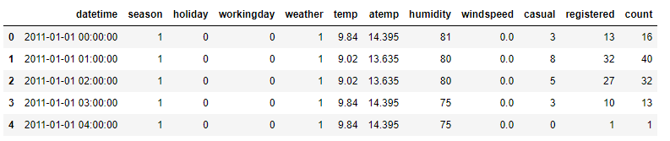
Quick Look

Slide 12
What is Exploratory Data Analysis?
Notes:
Exploratory data analysis (EDA) is used by data scientists to analyze and investigate data sets and summarize their main characteristics, often employing data visualization methods.
It helps determine how best to manipulate data sources to get the answers you need, making it easier for data scientists to discover patterns, spot anomalies, test a hypothesis, or check assumptions.

Slide 13
EXPLORATORY DATA ANALYSIS (EDA)
Handle Missing value
Removing duplicates
Outlier Treatment
Normalizing and Scaling
Encoding Categorical variables
Bivariate Analysis

Slide 14
EXTRACTING DATE
Since datetime object cannot be used for training model, so we have to convert it into Integer or Float values
HOUR INTEGER 0-23
DAY INTEGER 0-6
MONTH INTEGER 1-12
DATETIME
Notes:
Removing Datetime column and adding hour day & month columns
HOUR is 0-23 (24 hour format)
DAY is WEEKDAYS (0-6) 0 is monday and 6 is sunday
MONTH is 1-12 Jan-Dec

Slide 15
DATA VISUALIZATION
02
Data Visualization and Feature Engineering

Slide 16
What is DATA VISUALIZATION?
Notes:
Data visualization is the graphical representation of information and data. By using visual elements like charts, graphs, and maps, data visualization tools provide an accessible way to see and understand trends, outliers, and patterns in data.
Why ? Our eyes are drawn to colors and patterns. We can quickly identify red from blue, square from circle.
When we see a chart, we quickly see trends and outliers. If we can see something, we internalize it quickly. It’s storytelling with a purpose. If you’ve ever stared at a massive spreadsheet of data and couldn’t see a trend, you know how much more effective a visualization can be.

Slide 17
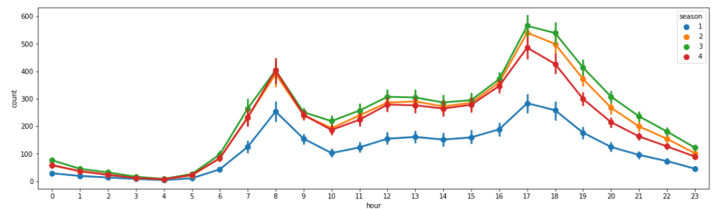
Pointplot of Hourly Trend of Average Count for every Season
Season-3 (fall) has most count of users and season-1 (spring) has least count of users on hourly basis

Slide 18
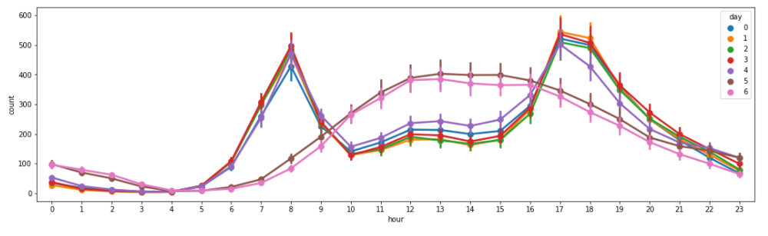
Pointplot of Hourly Trend of Average Count for every WeekDay
Weekends(5,6) and Weekdays(0,1,2,3,4) have different Trend of count of users on hourly basis.

Slide 19
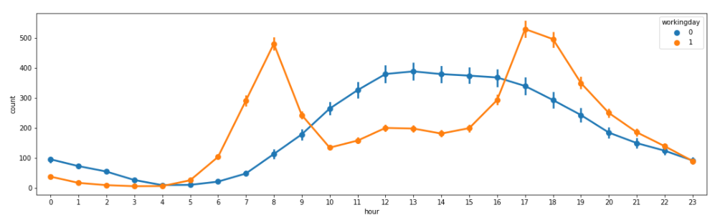
Introducing feature “PEAK” into the dataset using data visualization
Introducing a New Feature “PEAK”
Pointplot of Hourly Trend of Average Count for Working Day / Non-Working Day
We can see:
8, 17 & 18 are peak hours on working days
11-17 are peak hours on non-working days

Slide 20
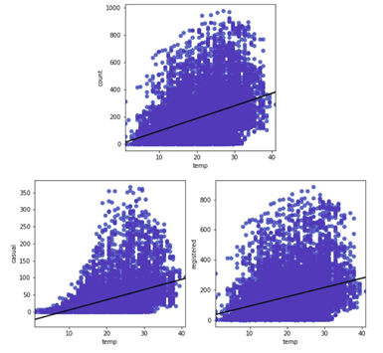
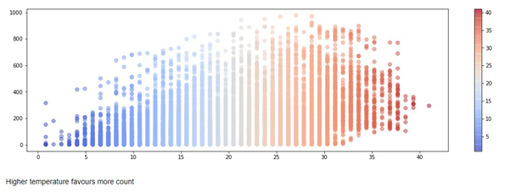
Temperature Relation
We can see the numbers increasing towards the orange ( Higher temp )
Higher the Temp -> Higher the Bike sharing count

Slide 21
What is Feature Selection ?
Notes:
Feature Selection is the process where you automatically or manually select those features which contribute most to your prediction variable or output in which you are interested in. Having irrelevant features in your data can decrease the accuracy of the models and make your model learn based on irrelevant features.

Slide 22
Benefits of feature selection
01
02
03
Less redundant data
Less misleading data
Reduces Training Time
Reduces Overfitting
Improves Accuracy
Reduces Algorithm complexity
Notes:
What are Benefits of performing feature selection before modeling your data?
· Reduces Overfitting: Less redundant data means less opportunity to make decisions based on noise.
· Improves Accuracy: Less misleading data means modeling accuracy improves.
· Reduces Training Time: fewer data points reduce algorithm complexity and algorithms train faster.

Slide 23
Feature Selection methods
Feature Importance
Univariate Selection
Correlation heatmap with matrix
3
1
2

Slide 24
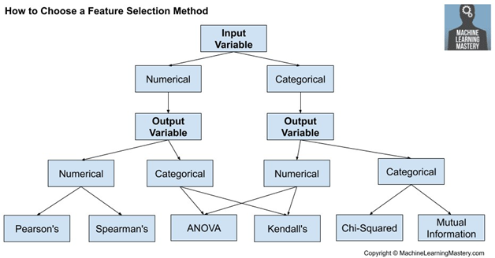
Univariate Statistical Measures
According to our model
Input Variable
Numerical
Output Variable
Numerical
Pearson’s
Our Case

Slide 25
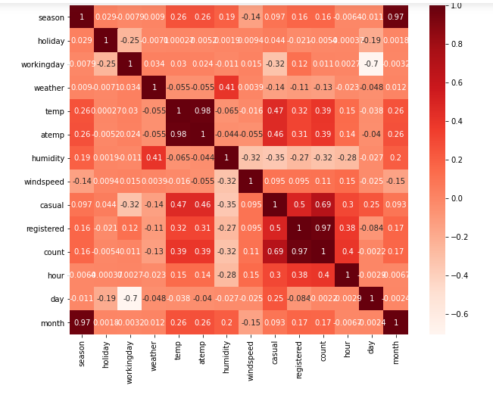
Plotting a Correlation HEATMAP
Observations:
Season and Month are highly correlated
Registered and Count are highly correlated
Temp and atemp are highly correlated
Notes:
A correlation heatmap is a heat map that shows a 2D correlation matrix between two discrete dimensions. The color of the cell is proportional to the number of measurements that match the dimensional value. This makes correlation heatmaps ideal for data analysis since it makes patterns easily readable and highlights the differences and variation in the same data.

Slide 26
TOP FEATURES FOR CASUAL COUNT
Time(Hour)
Humidity
Temp
Working Day
Peak

Slide 27
TOP FEATURES FOR REGISTERED COUNT
Time(Hour)
Humidity
Month
Working Day
Peak

Slide 28
MODELING
03
Modeling and HyperParameter Tuning
Notes:
So, We have understood our data and have found out the important features out of it , It is time to train our model.
The process of modeling means training a machine learning algorithm to predict the labels from the features, Tuning it for the business need, and validating it on holdout data.
The output from modeling is a trained model that can be used for inference, making predictions on new data points.
The objective of machine learning is not a model that does well on training data, but one that demonstrates it satisfies the business need and can be deployed on live data.

Slide 29
Regression
Supervised
Our Case
Models
Classification
Un-supervised
Clustering
Notes:
General Classification of Machine Learning Models
Supervised learning is the types of machine learning in which machines are trained using well "labelled" training data, and on basis of that data, machines predict the output.
UnSupervised learning
But there may be many cases in which we do not have labeled data and need to find the hidden patterns from the given dataset.
Regression analysis is a statistical method to model the relationship between a dependent (target) and independent (predictor) variables with one or more independent variables. the output for continuous values
Classification : When we try predict the categorical values, we need Classification algorithms.
Eg : Yes or No, 0 or 1, Spam or Not Spam, cat or dog, etc.
“Clustering” is the process of grouping similar entities together. The goal of this unsupervised machine learning technique is to find similarities in the data point and group similar data points together.

Slide 30
ALGORITHMS FOR REGRESSION
Linear Regression
Decision Trees
Random Forest
Adaptive Boost
Gradient Boost
XGBoost
Notes:
To discuss:
Linear Regression - Linear Regression establishes a relationship between dependent variable (Y) and one or more independent variables (X) using a best fit straight line (also known as regression line).
Decision Trees - Decision Trees are a type of Supervised Machine Learning where the data is continuously split according to a certain parameter. The tree can be explained by two entities, namely decision nodes and leaves. The leaves are the decisions or the final outcomes. And the decision nodes are where the data is split
Ensemble Learning - Ensemble learning method is a technique that combines predictions from multiple machine learning algorithms to make a more accurate prediction than a single model.
Bagging
Random Forest - Random Forest Regression is a supervised learning algorithm that uses ensemble learning method for regression. constructing a multitude of decision trees at training time. (highest occurring value i.e mode )
Boosting
-The term ‘Boosting’ refers to a family of algorithms which converts weak learner to strong learners.,To convert weak learner to strong learner, we’ll combine the prediction of each weak learner. The idea of boosting is to train weak learners sequentially, each trying to correct its predecessor.
Adaptive Boost
Gradient Boost
XGBoost
-eXtreme Gradient Boosting
Execution Speed.
Model Performance.
Parallelization - of tree construction using all of your CPU cores during training.
Distributed Computing - training very large models
Out-of-Core Computing - very large datasets that don’t fit into memory.
Cache Optimization - best use of hardware.

Slide 31
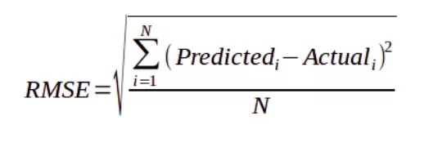
EVALUATION METRIC
An evaluation metric quantifies the performance of a predictive model. This typically involves training a model on a dataset, using the model to make predictions on a holdout dataset not used during training, then comparing the predictions to the expected values in the holdout dataset.
We Used: Root Mean Square Error (RMSE)
Notes:
Evaluation metrics are used to measure the quality of the statistical or machine learning model.
RMSE is calculated as the square root of the mean of the squared differences between actual outcomes and predictions.
We know that residuals are a measure of how distant the points are from the regression line. Thus, RMSE measures the scatter of these residuals.
Other technique :
Mean Absolute Error(MAE) R^2 Mean Squared Error(MSE)
RMSE ADvANtage : The output value you get is in the same unit as the required output variable which makes interpretation of loss, easy. RMSE penalizes large errors
.

Slide 32
MODELING TIMELINE
CREATE
PREDICT
STEP 2
STEP 4
STEP 1
STEP 3
TRAIN
EVALUATE
Declare Model of Specific Algorithm
Get Predictions from Model of Test Data
Train data on the Model
Evaluate Model’s Performance on the basis of RMSE

Slide 33

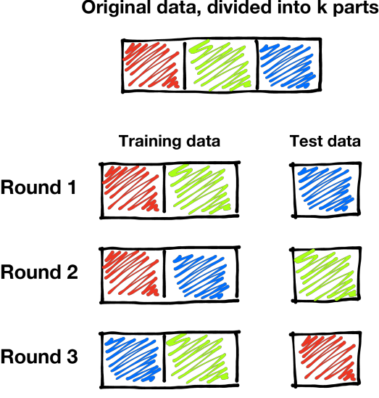
CROSS VALIDATION
Cross-validation is a resampling procedure used to evaluate machine
learning models on a limited data sample.
The general procedure is as follows:
Shuffle the dataset randomly.
Split the dataset into k groups
For each unique group:
Take the group as a hold out or test data set
Take the remaining groups as a training data set
Fit a model on the training set and evaluate it on the
test set
Retain the evaluation score and discard the model
Summarize the skill of the model using the sample of model
evaluation scores
Notes:
problem with this evaluation technique is that it does not give an indication of how well the learner will generalize to an independent/ unseen data set. Getting this idea about our model is known as Cross Validation.
We need some kind of assurance that your model has got most of the patterns from the data correct, and its not picking up too much on the noise, or in other words its low on bias and variance.
Cross-validation is primarily used Estimate the skill of a machine learning model on unseen data. That is, it uses a limited sample in order to estimate how the model is expected to perform in general ,
when used to make predictions on data not used during the training of the model.
It is a popular method because it is simple to understand and because it generally results in a less biased estimate than other methods, such as a simple train/test split.

Slide 34
HYPERPARAMETER TUNING
Grid Search
HP Tuning
Random Search
Notes:
A Machine Learning model is defined as a mathematical model with a number of parameters that need to be learned from the data. By training a model with existing data, we are able to fit the model parameters.
However, there is another kind of parameters, known as Hyperparameters, that cannot be directly learned from the regular training process.
They are usually fixed before the actual training process begins.
Eg : Decision Trees in Random Forest
These parameters express important properties of the model such as its complexity or how fast it should learn.

Slide 35
OUR TOP RESULTS
XGBRegressor
RandomForestRegressor
XGBRegressor
RandomForestRegressor
RMSE Before and After Hyperparameter Tuning
16.31
For predicting “Casual”
14.91
16.73
For predicting “Casual”
15.92
53.52
For predicting “Registered”
51.95
57.06
For predicting “Registered”
54.27

Slide 36
LET’S JUMP
INTO THE
JUPYTER NOTEBOOK

Slide 37
THANK YOU!

Slide 38
We are open to Questions...

